Slide 1
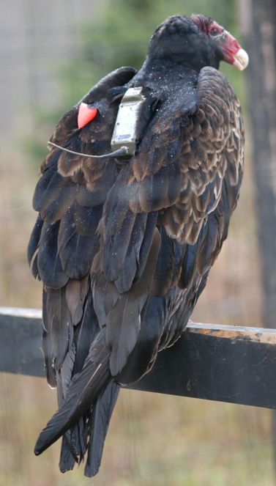
Discovering Relationships between Climate and Animal Migration with New Tools for Linking Animal Movement Tracks, Weather and Land Surface Data
Gil Bohrer, Roland Kays, Jiawei Han, David Brandes, David Doulas, Steve Garrity, Martin Wekelski

Slide 2
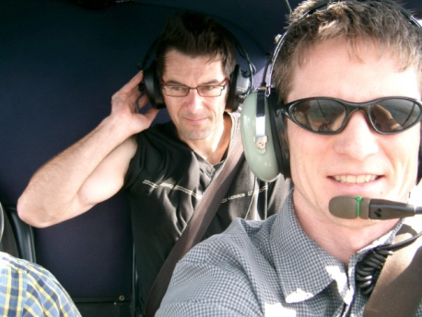
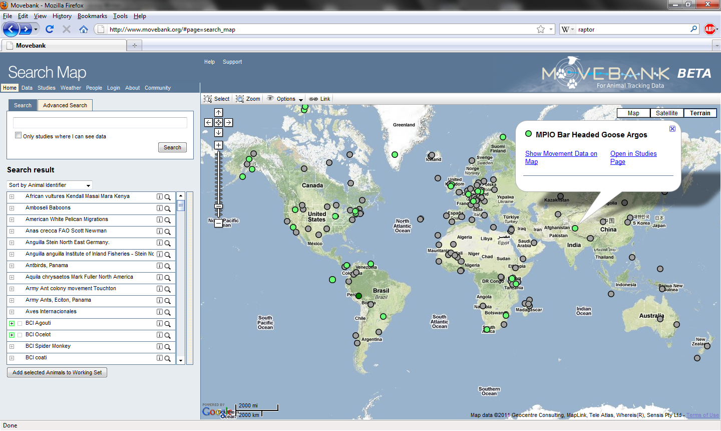
www.movebank.org
What to do with track data?

Slide 3
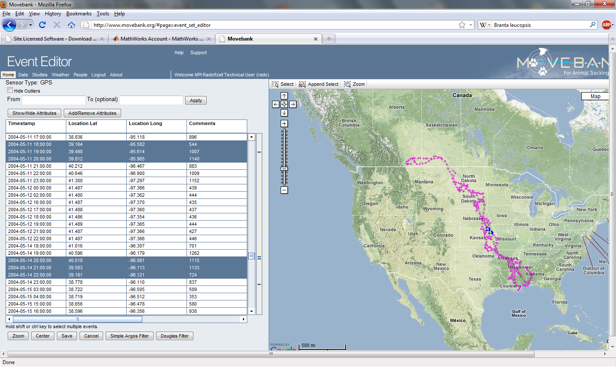
Graphic data editing tool

Slide 4
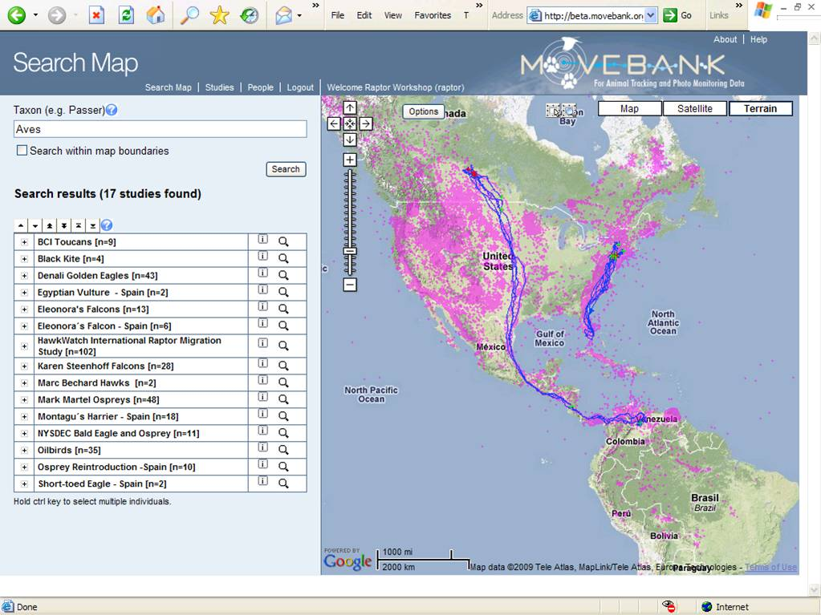
Plotting tools – individual/species/study highlight

Slide 5
Additional data support – physiological sensors, accelerometers, environmental sensors

Slide 6
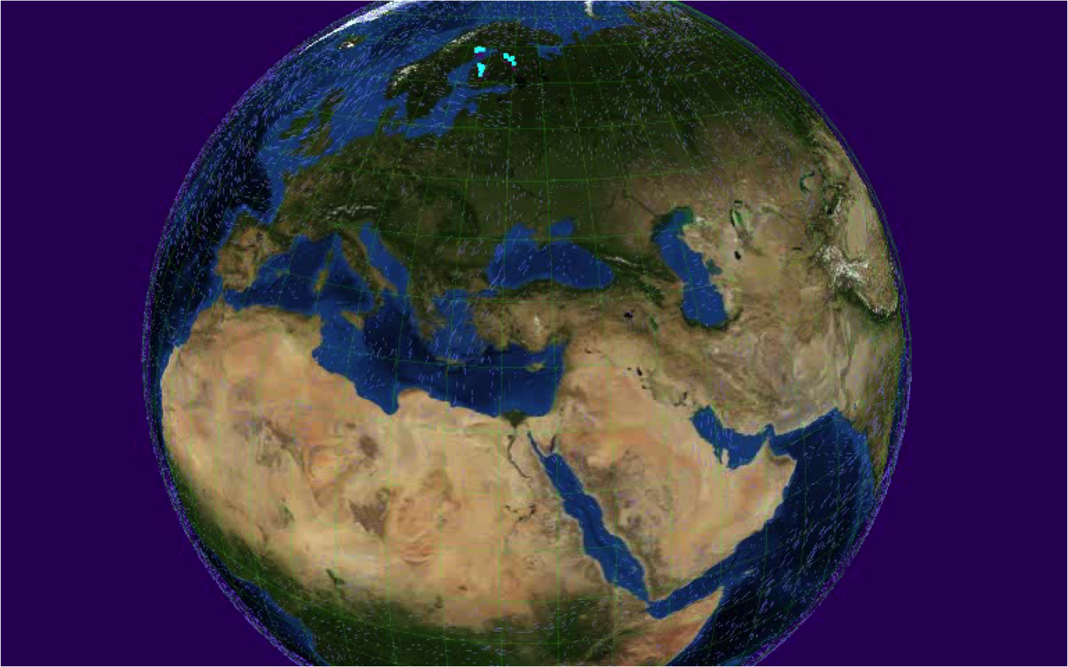
Movement is tightly linked with the environment – along the path, and the path not taken

Slide 7
Environmental- Data Automated Track-Annotation System Env-DATA
Provides easy-to-use coupling between movement data and remote sensing, weather and other environmental and human global datasets

Slide 8
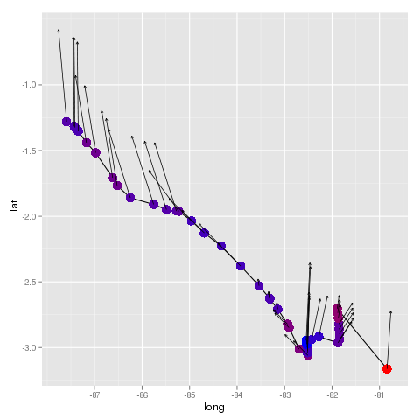
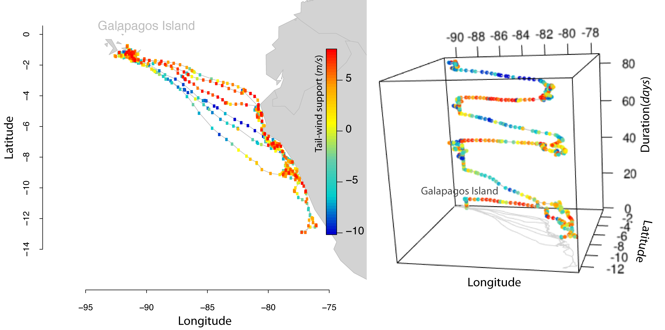
Track annotation – linking environmental data to observed track points
Albatross movement to Galapagos

Slide 9
Datasets | Data Source | Temporal Coverage
Tropical Rainfall Measuring Mission (TRMM) | NASA http://trmm.gsfc.nasa.gov/ | 1998– present
AVHRR land NDVI | NASA http://glcf.umiacs.umd.edu/data/gimms/ | 1989–present, 1982–present
NCEP Global Reanalysis 2 | NOAA http://www.esrl.noaa.gov/psd/data/gridded/data.ncep.reanalysis2.html/ | 1948–present
North American Regional Reanalysis | NOAA http://www.emc.ncep.noaa.gov/mmb/rreanl/ | 1979–present
ECMWF Reanalysis | ECMWF http://www.ecmwf.int/ | 1979–present
MODIS Land | NASA https://lpdaac.usgs.gov/ | 2002–2012
MODIS Ocean | NASA http://oceancolor.gsfc.nasa.gov/
MODIS Snow | NASA http://modis-snow-ice.gsfc.nasa.gov/
Ocean productivity | http://www.science.oregonstate.edu/ocean.productivity/ | 1997–2009
ASTER GDEM | USGS http://asterweb.jpl.nasa.gov/gdem.asp
SRTM | NASA http://www.cgiar-csi.org/data/srtm-90m-digital-elevation-database-v4-1/
GlobCover | ESA http://dup.esrin.esa.it/prjs/prjs68.php | 2009
Socioeconomic data | http://sedac.ciesin.columbia.edu/gpw/global.jsp | 1990–2010
Ocean Surface Current Reanalysis (OSCAR) | NASA http://www.oscar.noaa.gov/ | 1993–present
ETOPO1 | NASA http://www.ngdc.noaa.gov/mgg/global/global.html/ | 1940–2008

Slide 10
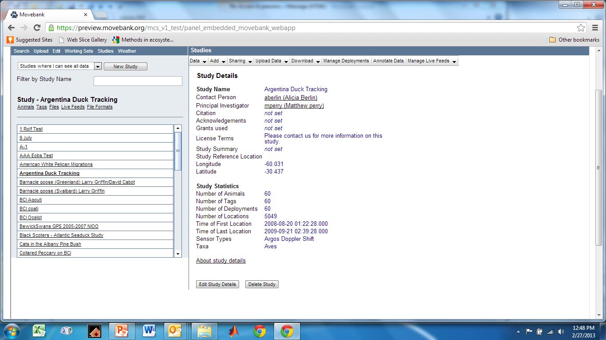

Slide 11
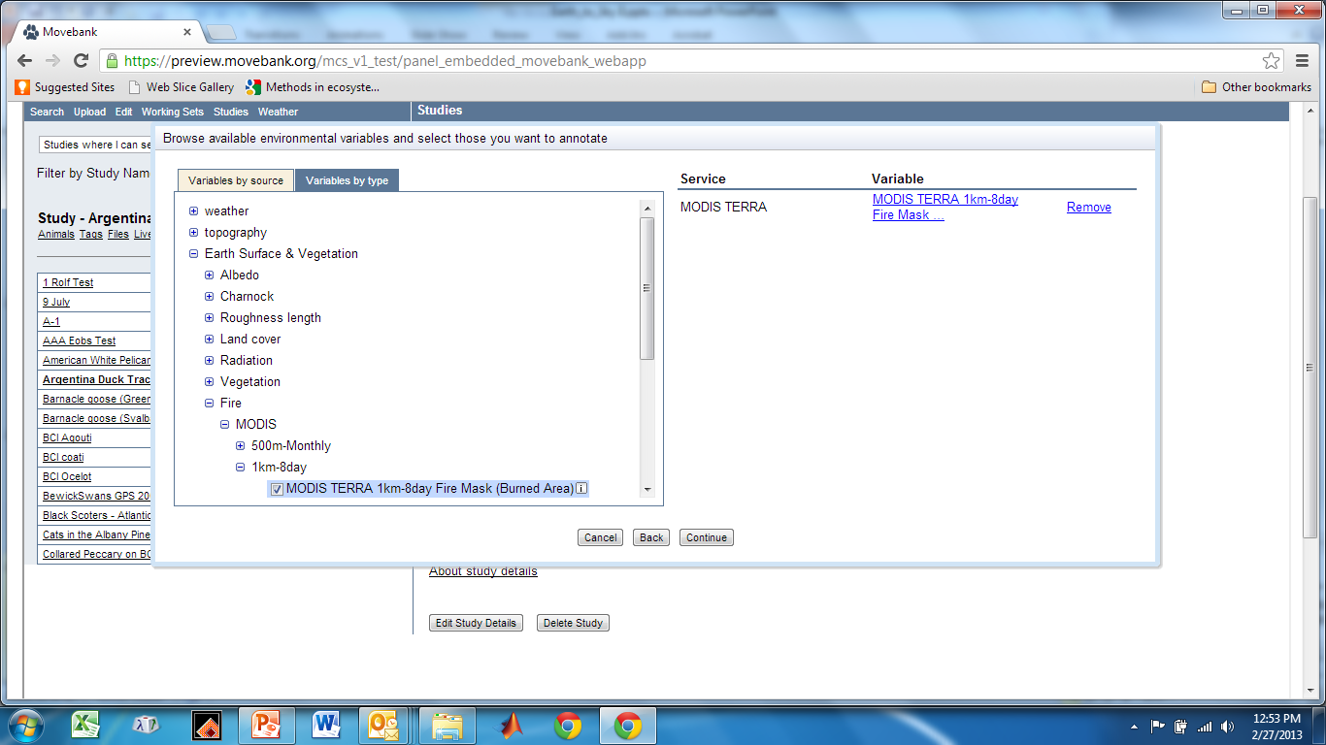

Slide 12
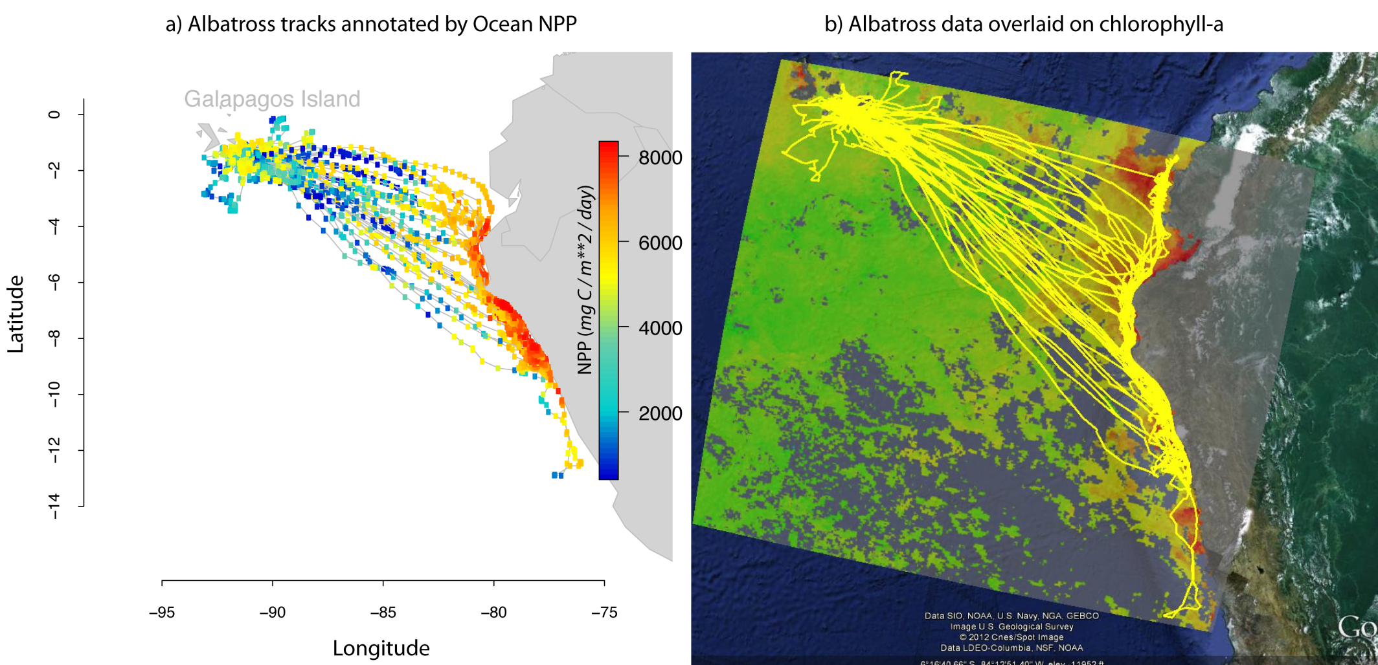
Data exploration tools
Annotated track data
Data over a gridded region

Slide 13
Track annotation – linking environmental data to observed track points
Time cube

Slide 14
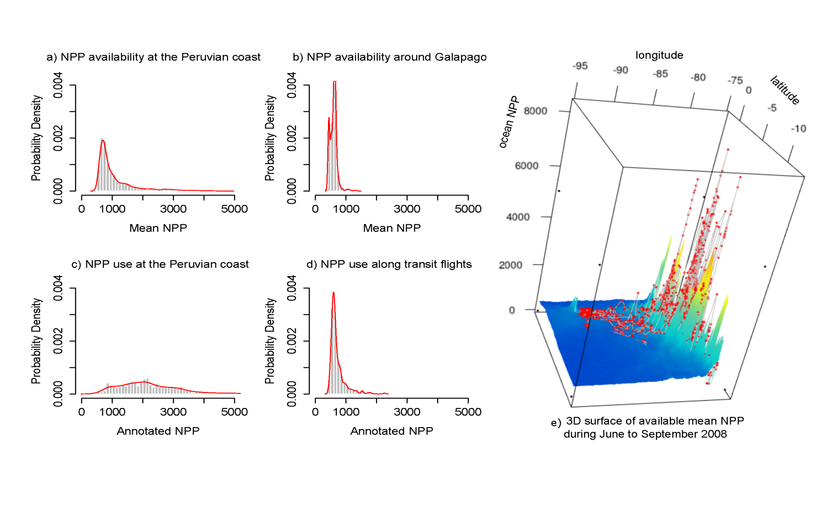
Data Analysis tools
Peruvian Coast
Around Galapagos
Available ocean productivity
Used ocean productivity
Distribution of used conditions vs. available conditions

Slide 15
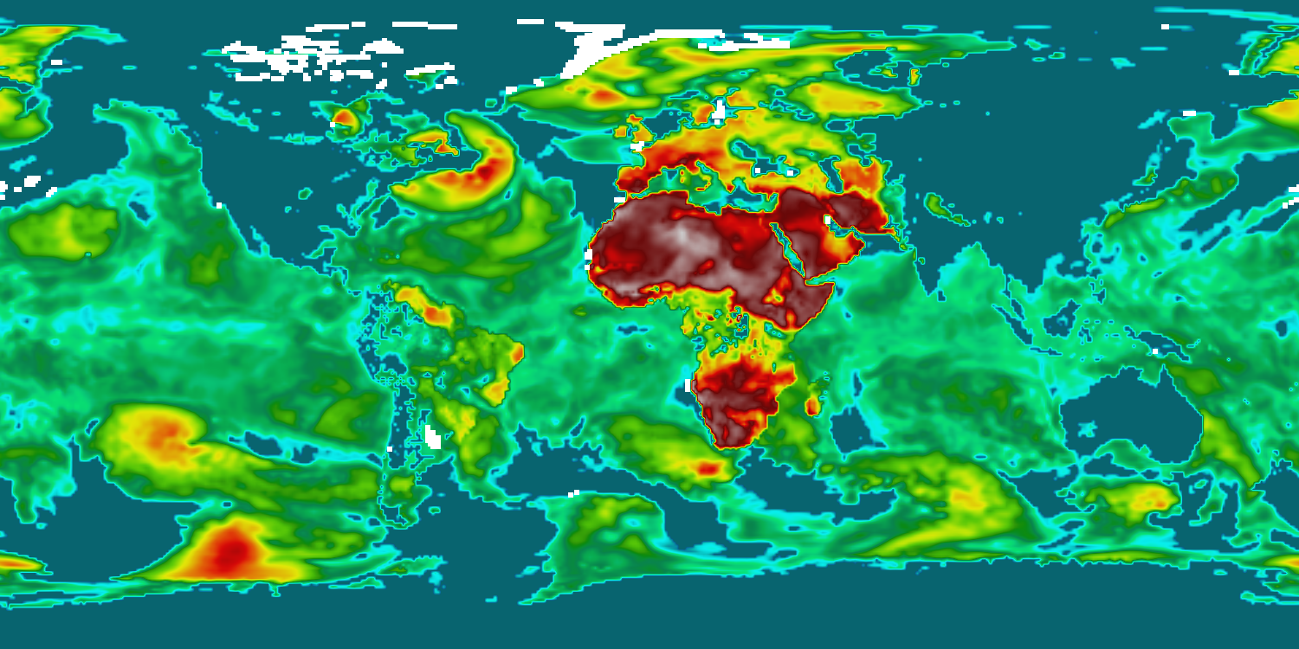
Derived Variables
Thermal uplift

